Slide 1




BSIT - 2
EVENT DRIVEN PROGRAMMING
GROUP 5
SPINFINITY
Discover the ultimate solution for random winner selection in our project, making it not only efficient but also fun!
Development Team:
Carl Wyne S. Gallardo
Marly Shan Penales

Slide 2


Introduction
Target Users
Spinfinity is your gateway to seamless and entertaining random winner selection in our project. Powered by .NET Framework C#, this innovative tool promises to bring excitement and efficiency to your selection process. Whether you're organizing a contest, raffle, or any event that requires randomness, Spinfinity has you covered. Say goodbye to the tedious and hello to the thrilling world of chance with Spinfinity!
Event organizers, live streamers, contest hosts, and individuals looking for an enjoyable and efficient solution for random winner selection in a variety of projects and events.

Slide 3


THE EACH FORMS OF THE APPLICATION
Features of Each Form:
Cyber Theme
Design Consistency
Sound Effects

Slide 4
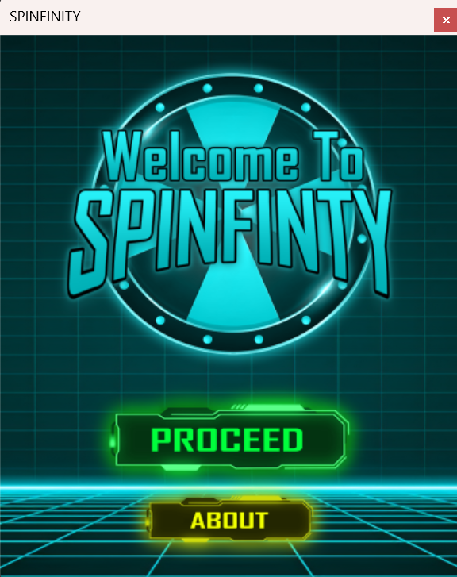
1st Form
Welcome Page
Welcomes the User to the Application
They can choose to navigate to Form2 or Form3

Slide 5
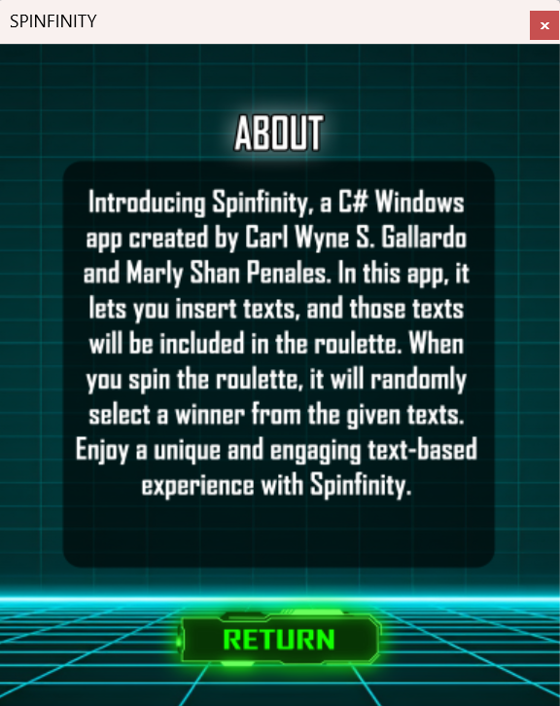
2nd Form
About Page
Introduces the Application Functionalities
Button that navigates to Form1

Slide 6
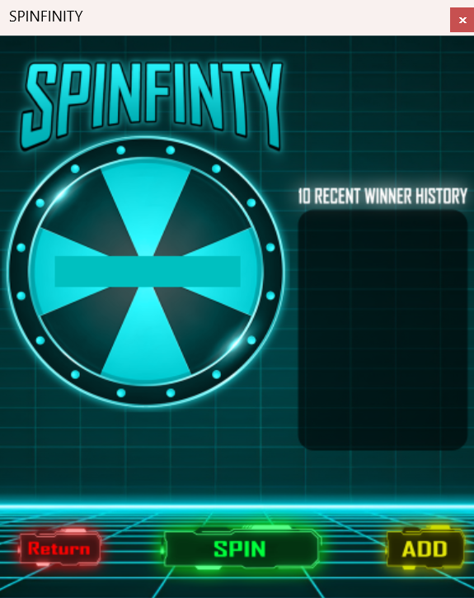
3rd Form
Spin Page
They can choose a navigation to Form1 or Form4
It can spin if there is an available list of names in Form4
Lists 10 Recent Winners selected from random spin

Slide 7
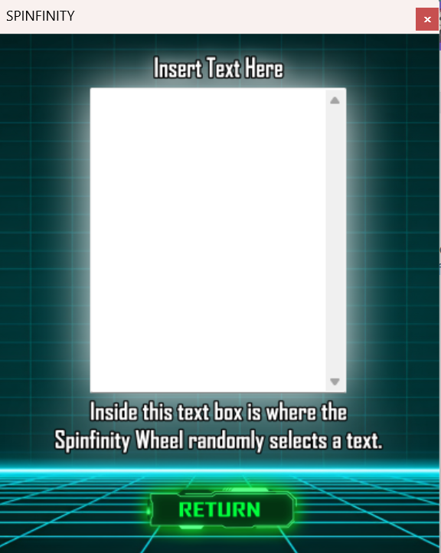
4rd Form
Adding-Text Page
You can type names into the text box to create a list for random selection on the Spin
Button that navigates to Form3

Slide 8
Why we come up to make this application?
We were inspired by the popularity of live streams where giveaways are conducted using a random selection tool to pick a winner from the streamer's fanbase. Additionally, our idea took root from the familiar and enjoyable concept of the game "spin the bottle," which we aimed to reimagine in a digital format for various applications, contests, and events.

Slide 9



RELATED PROGRAMS TO THE PROJECT
Related Programs to the Project
Random Picker Tools
Wheel Decide
Rafflecopter
Various software solutions designed for random selection, ideal for giveaways, contests, and more.
A web-based tool that allows you to create custom wheels for random selections and decisions
A popular platform for running online giveaways and contests with built-in random selection features.
www.randompicker.com
www.wheeldecide.com
www.rafflecopter.com

Slide 10
Thank you for your time and attention

